Slide 1
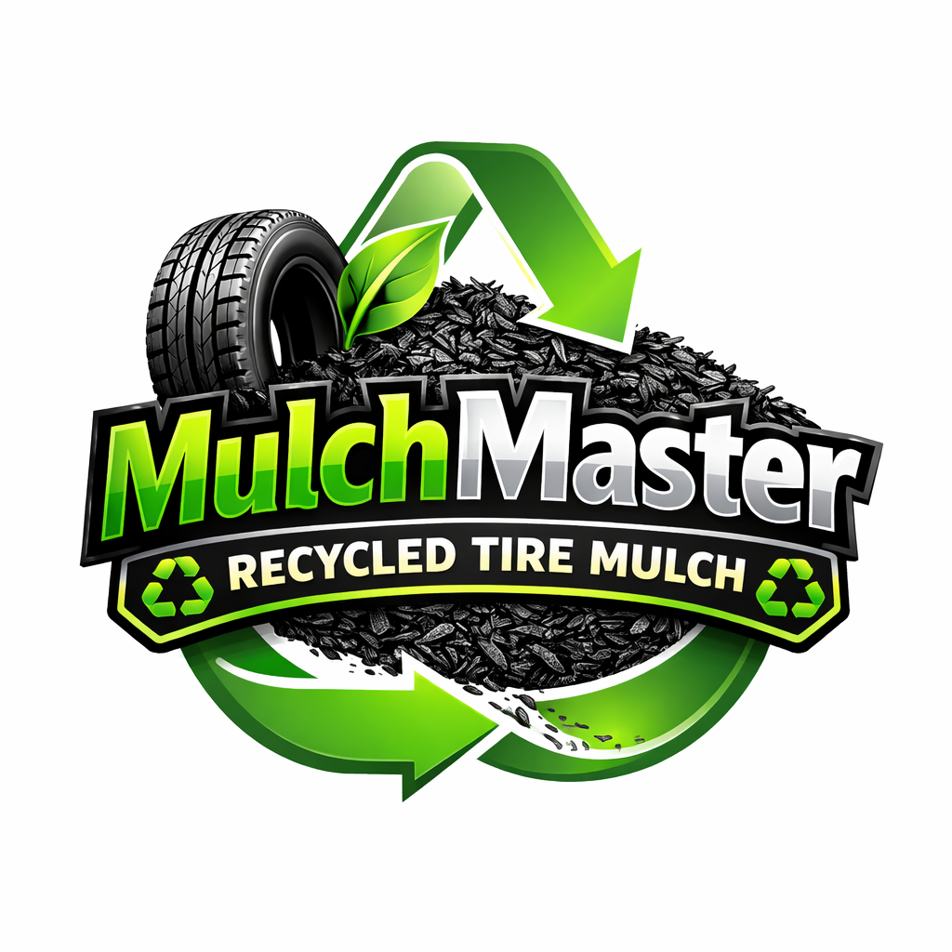

Slide 2
Introduction
Hi everyone, our names are John Hoekstra, Charlie Boxx, and Gavin Cuoio. Today, we are presenting our idea for a product called “M
- Made from recycled tires
- A better alternative for the environment
-

Slide 3
Problem
Every year, over 300 million tires are discarded in the United States alone. These tires don’t decompose easily, and when stockpiled, they create serious hazards. They’re breeding grounds for mosquitoes, they release toxic chemicals into soil and water, and tire fires can burn for months, causing long-term air pollution.
Despite these risks, millions of tires still end up in landfills or illegal dumping sites. The core problem isn’t just waste—it’s the lack of efficient, scalable, and profitable recycling solutions.

Slide 4
Solution
Mulch Masters Recycling addresses this by converting old, unusable tires into tire mulch, a durable, eco-friendly alternative to traditional wood mulch.
Our process involves:
Collecting discarded tires from local businesses and municipalities
Shredding and processing them into clean, safe mulch
Distributing the finished product to landscaping companies, schools, parks, and homeowners
Tire mulch has several advantages: it lasts up to 10 years, doesn’t attract insects, retains moisture better than wood, and reduces the need for constant replacement. It’s not just recycling—it’s creating a superior product.

Slide 5
Target market and research
Our primary target market includes:
Landscaping companies
Municipal parks and recreation departments
Schools and playground developers
Environmentally conscious homeowners
The U.S. landscaping services market alone is worth over $150 billion, and demand for sustainable materials is growing rapidly. Research shows that consumers and municipalities are increasingly willing to pay more for eco-friendly alternatives, especially those that reduce long-term maintenance costs.
Additionally, government regulations are tightening around tire disposal, which creates an opportunity for businesses like ours to step in as a compliant and cost-effective solution.

Slide 6
Competitive advantage
What sets Mulch Masters apart is our closed-loop, locally focused model.
First, we partner directly with tire retailers and auto shops to secure a steady, low-cost supply of raw materials. Many of these businesses actually pay to dispose of tires—so we can reduce their costs while securing inventory.
Second, we operate regionally, minimizing transportation costs and emissions while building strong local partnerships.
Third, our product is positioned as both eco-friendly and cost-effective over time. Unlike wood mulch, which needs to be replaced yearly, our tire mulch lasts for years—saving customers money.
Finally, we emphasize branding and education, helping customers understand both the environmental impact and the performance benefits of our product.

Slide 7
Call to action
We’re currently seeking partners and initial funding to scale our processing capacity and expand distribution. With your support, we can reduce landfill waste, create a profitable circular business, and make sustainable landscaping the standard—not the exception.
Join us in turning waste into value. Thank you.

